Slide 1
“Queering Ethics”
Archives at the Burke Library
at Union Theological Seminary
This deck of Google Slides contains animated content. Click “Present,” and press the button that advances the next slide, to view subsequent slides, pop-ups, and content in motion.
Intro to Information
Archival Processing 101
Ethics of the Archive
- - -
Handling archives at the Burke Library
Queer archives / queer research
Discussion and conclusion
Caro Bratnober (Spring 2019)
Columbia University Libraries

Slide 2
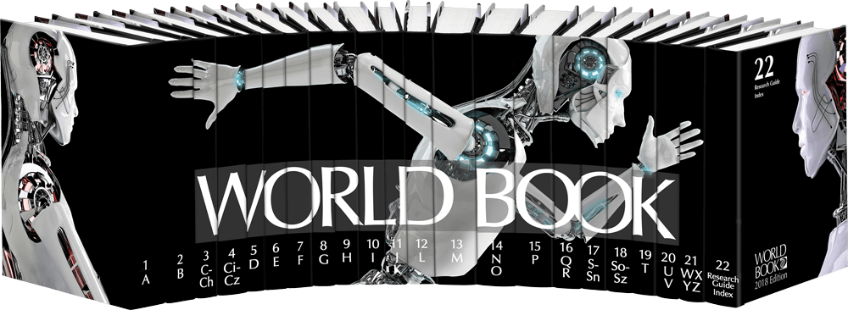
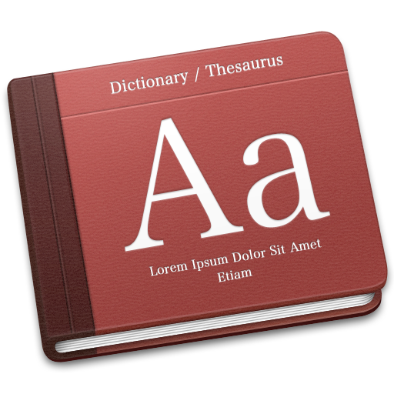
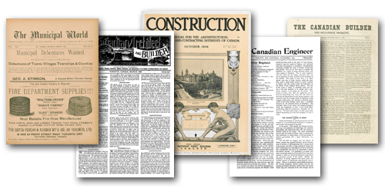
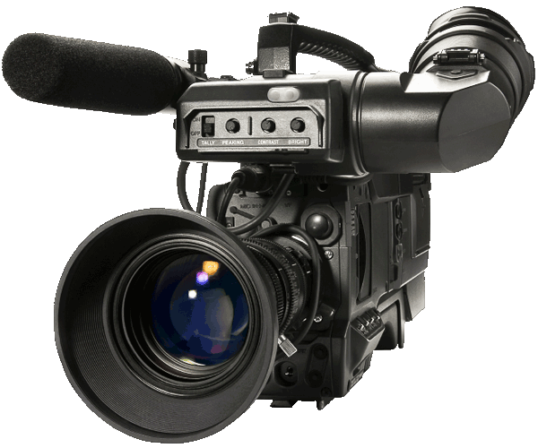
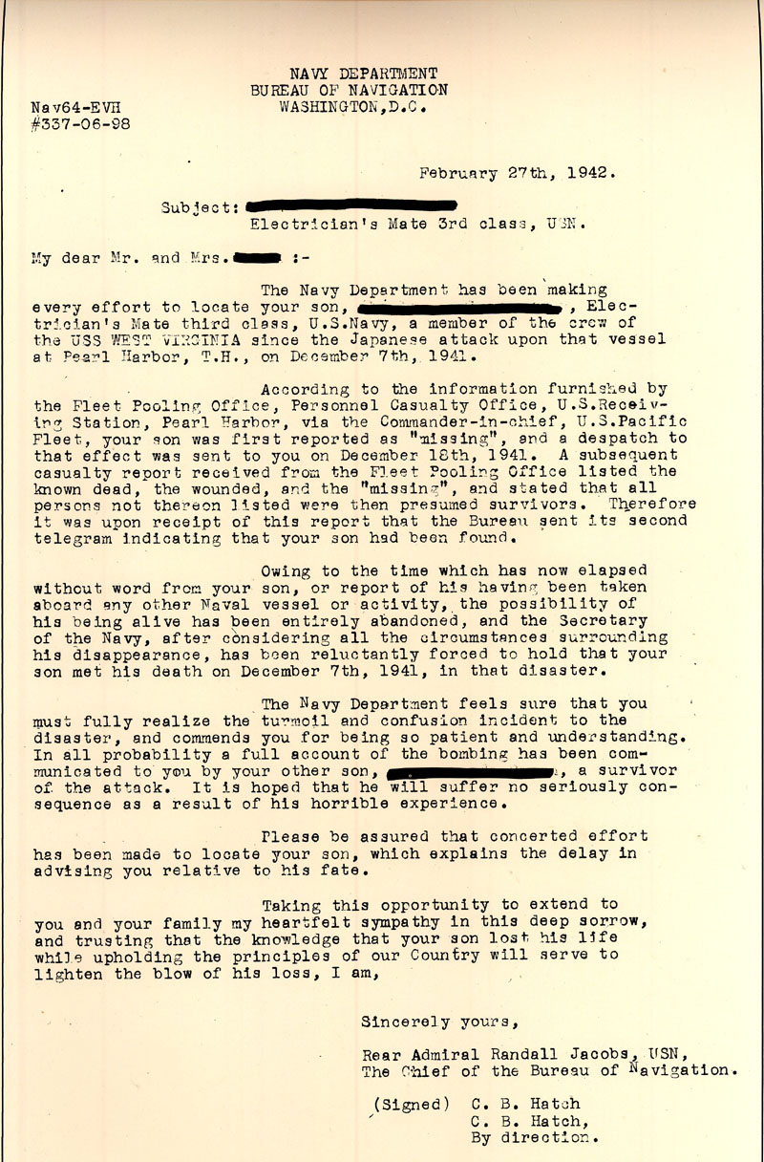
Grouping sources of information by time and analytical distance from the topic
reference sources
may include encyclopedias, summary information, resources for fast facts
secondary sources
insights and discussion of the topic, may
include monographs, periodicals, other media
primary sources
first-hand accounts of the topic
T
I
M
E
topic
what the researcher
is interested in
Where are archival materials?
ANALYTICAL DISTANCE
Caro Bratnober (Spring 2019)
Columbia University Libraries

Slide 3
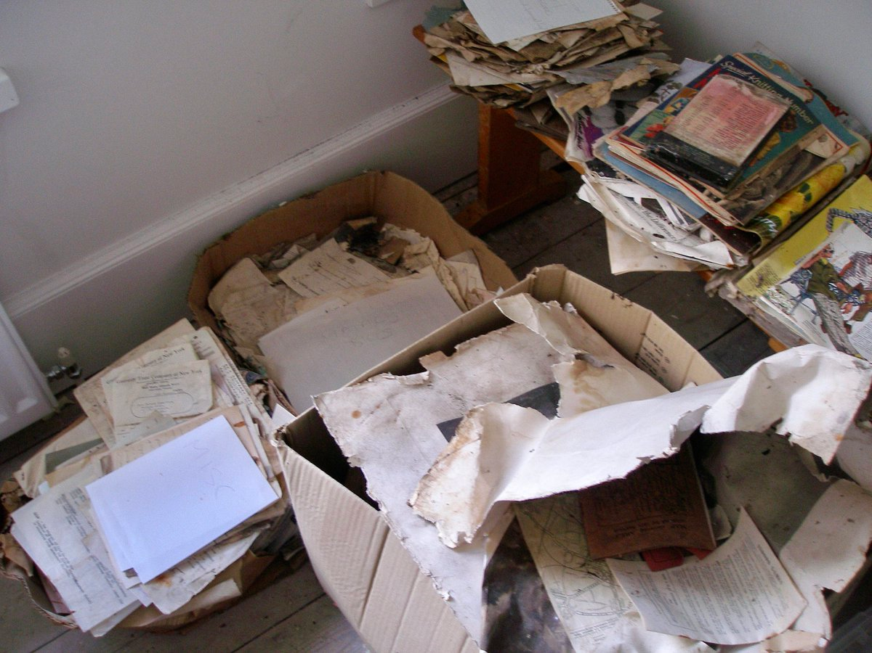
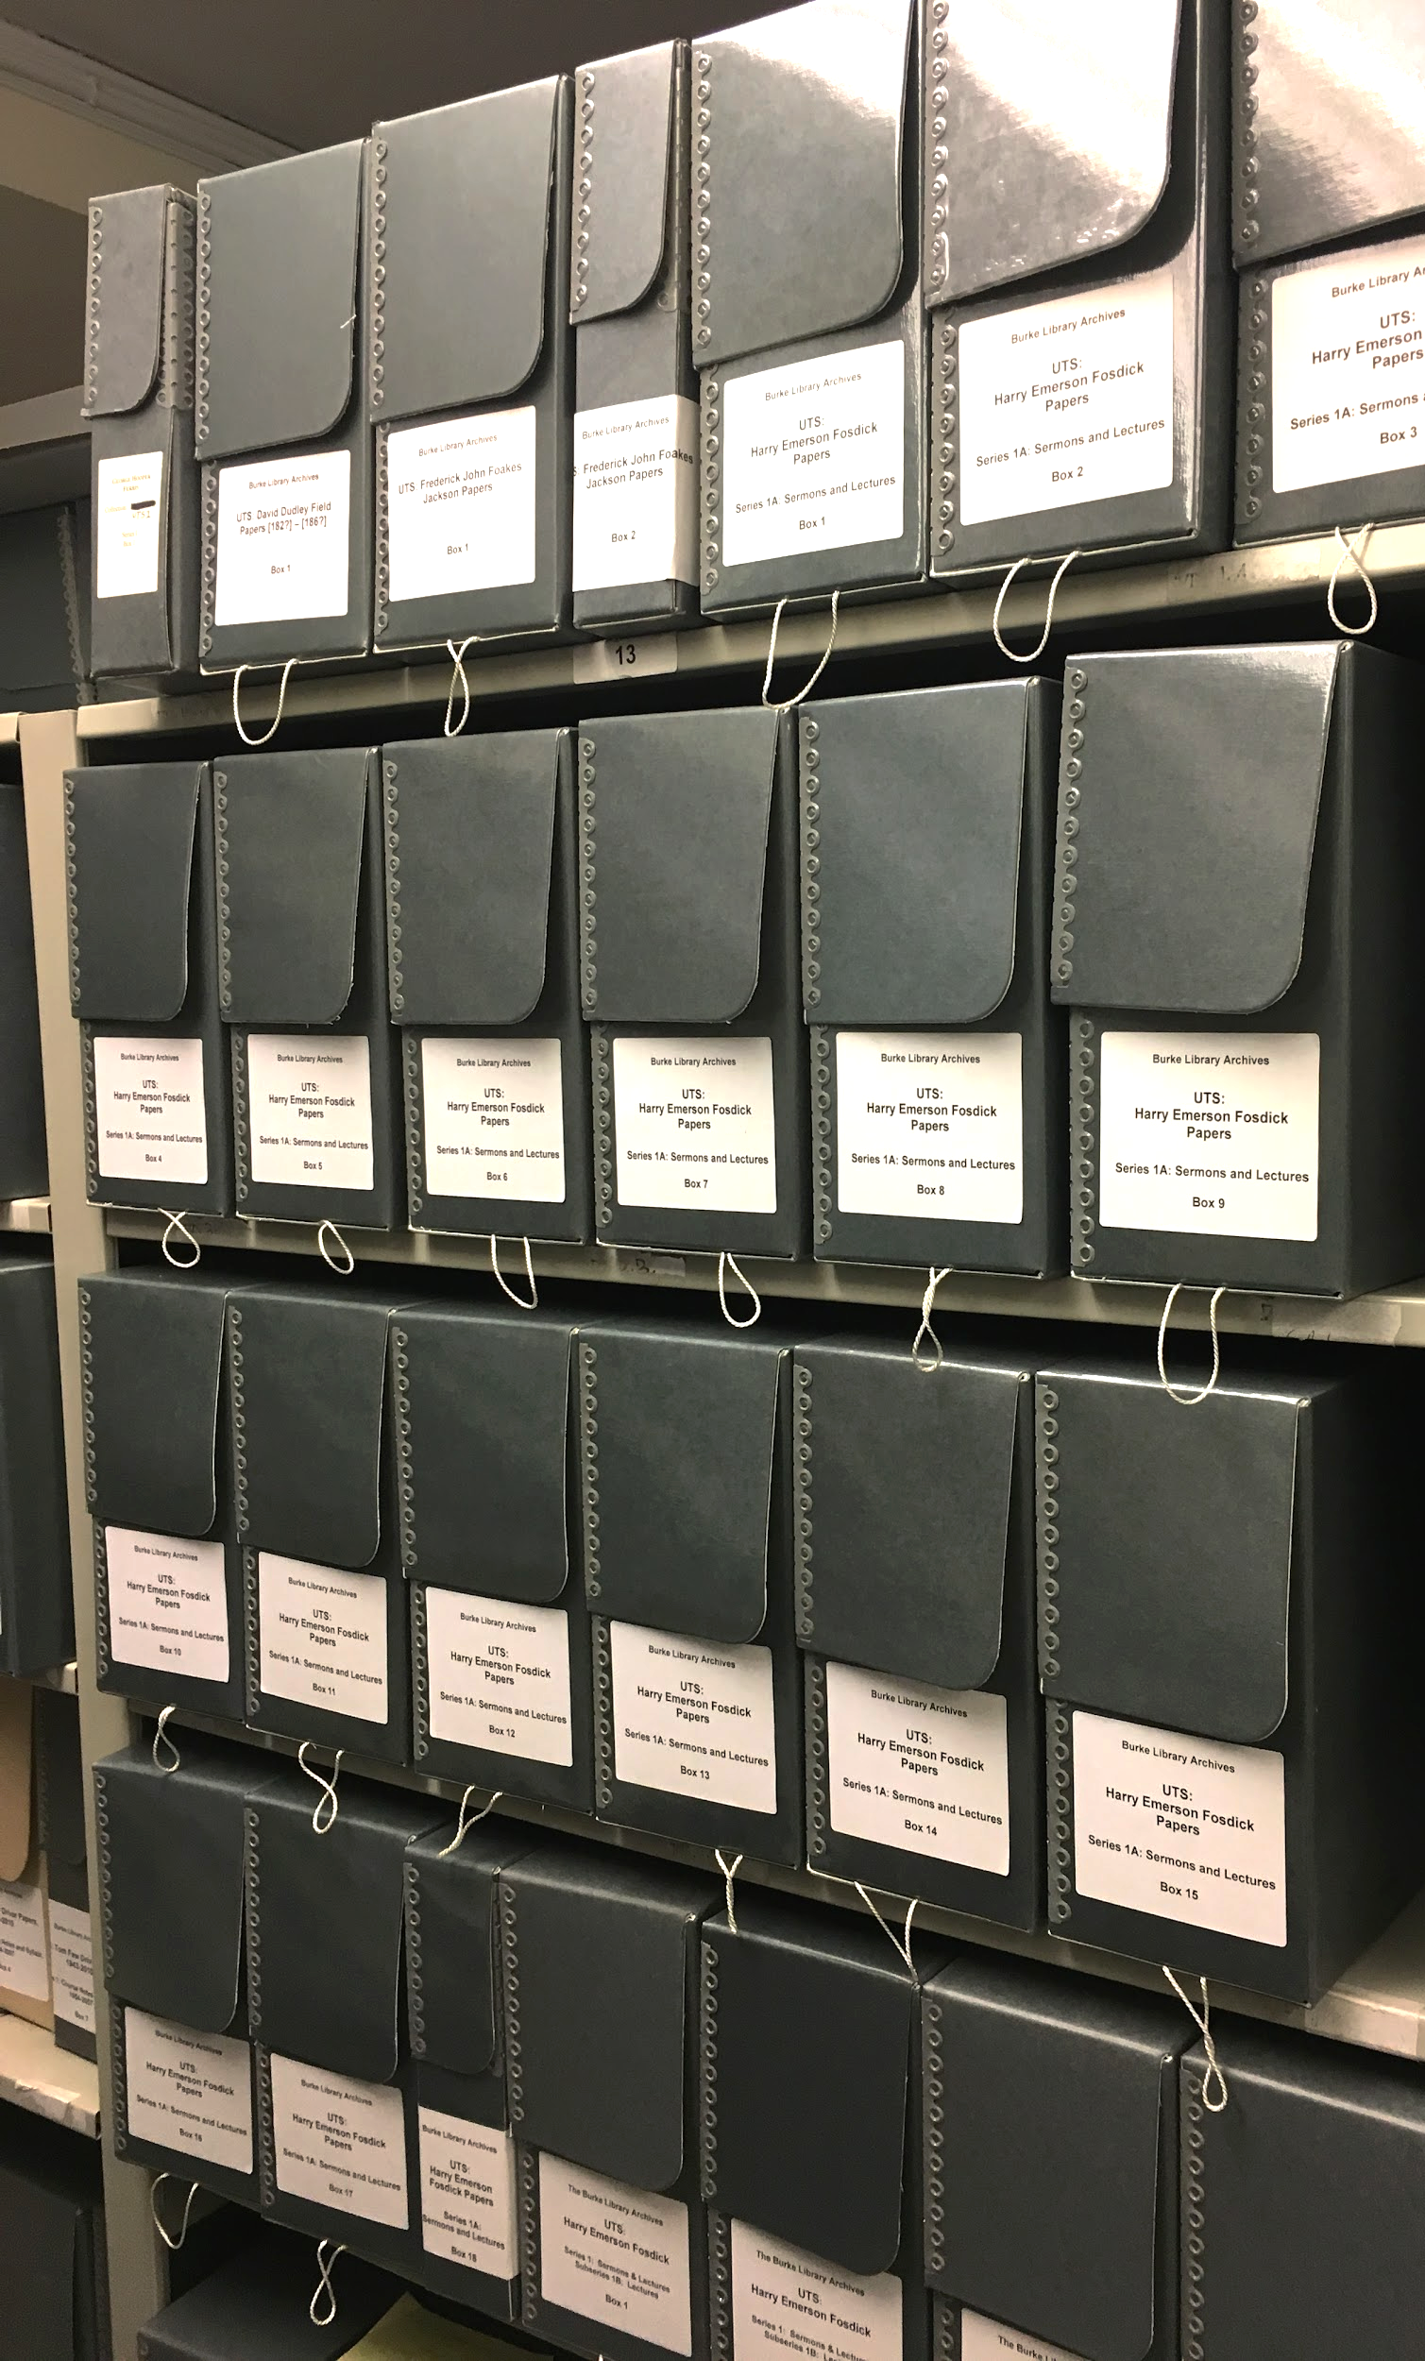
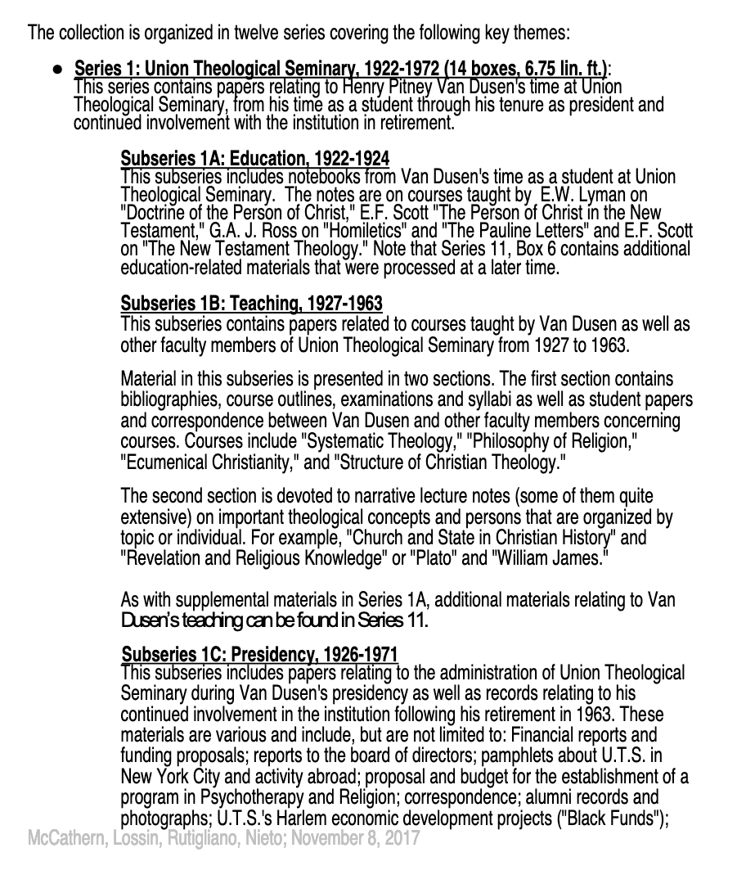
respect des fonds
Finding Aid:
archival processing
donation
selection
acquisition
preservation
identification
organization
interpretation
“more product, less process”
Caro Bratnober (Spring 2019)
Columbia University Libraries

Slide 4
Digitized and Born-Digital Archives
https://www.loc.gov/rr/main/lgbtq/lgbtqgeneralguide/digitalcollections.html
Caro Bratnober (Spring 2019)
Columbia University Libraries

Slide 5
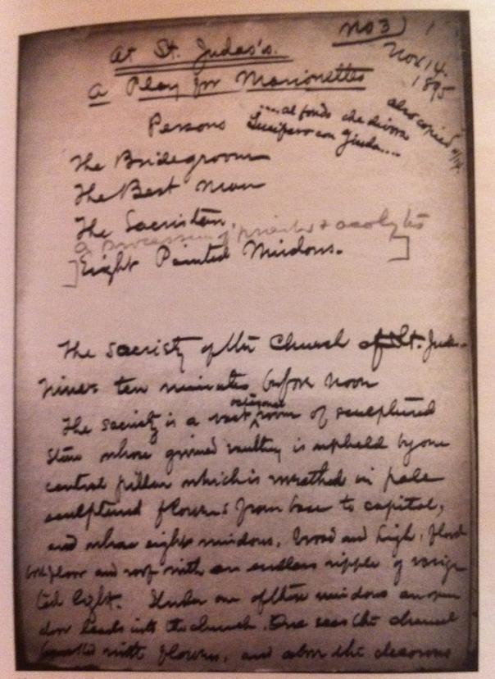
Image, scanned from reproduction of a manuscript page of Henry Blake Fuller’s At Saint Judas’s (1896),
in the Henry Blake Fuller papers, Newberry Library, Chicago Illinois
from “A Queer Victorian Marriage: Henry Blake Fuller’s At Saint Judas’s and the “Tyranny” of the Archival Document”
by Eric Colleary, in A Tyranny of Documents: The Performing Arts Historian as Film Noir Detective
edited by Stephen Johnson, published by the Theatre Library Association (New York: 2011)
Caro Bratnober (Spring 2019)
Columbia University Libraries

Slide 6
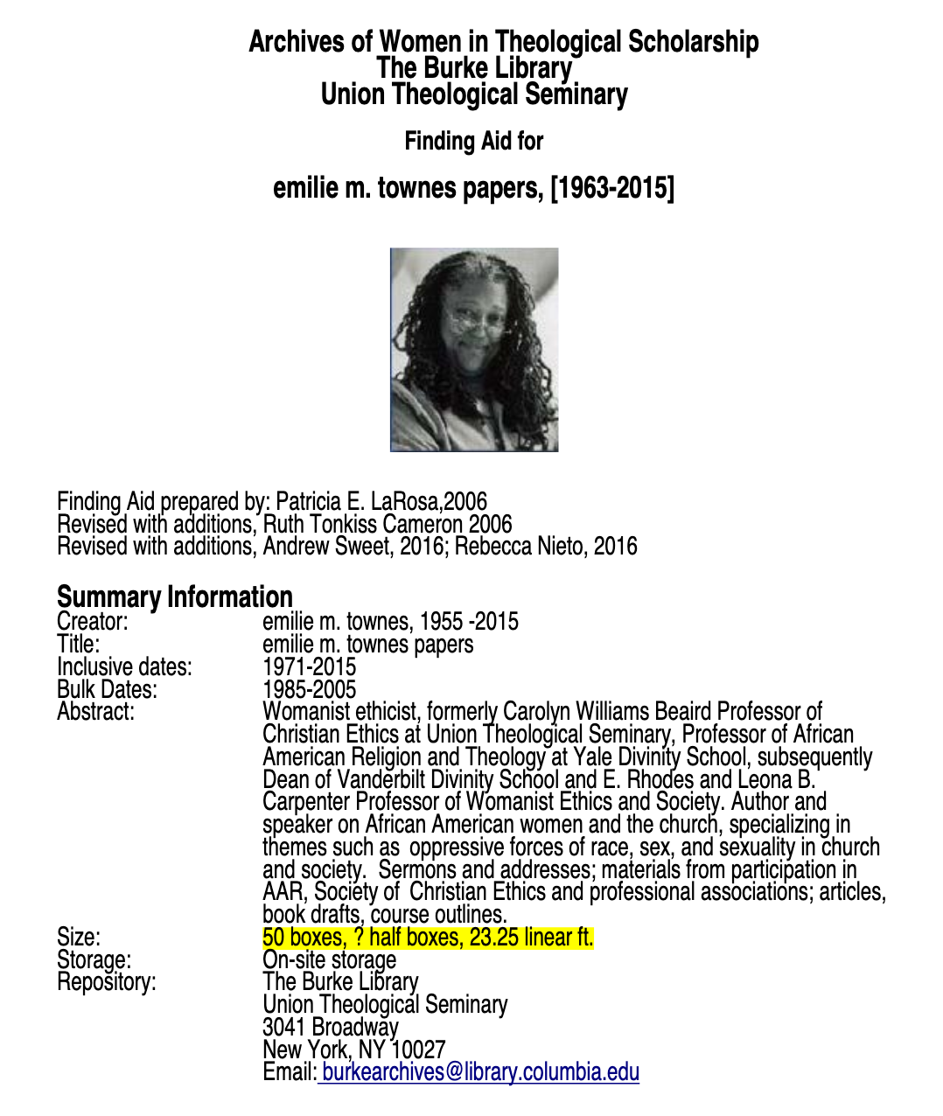
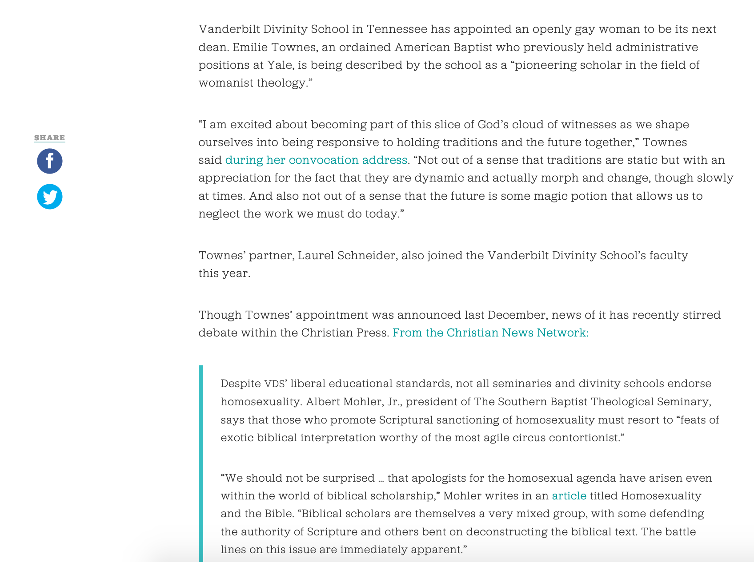
Burke Library Special Collections
Jamilah King. “Black Lesbian Minister Becomes Dean of Vanderbilt’s Divinity School.” Colorlines, October 9, 2013. colorlines.com
Caro Bratnober (Spring 2019)
Columbia University Libraries

Slide 7
Break

